Slide 1
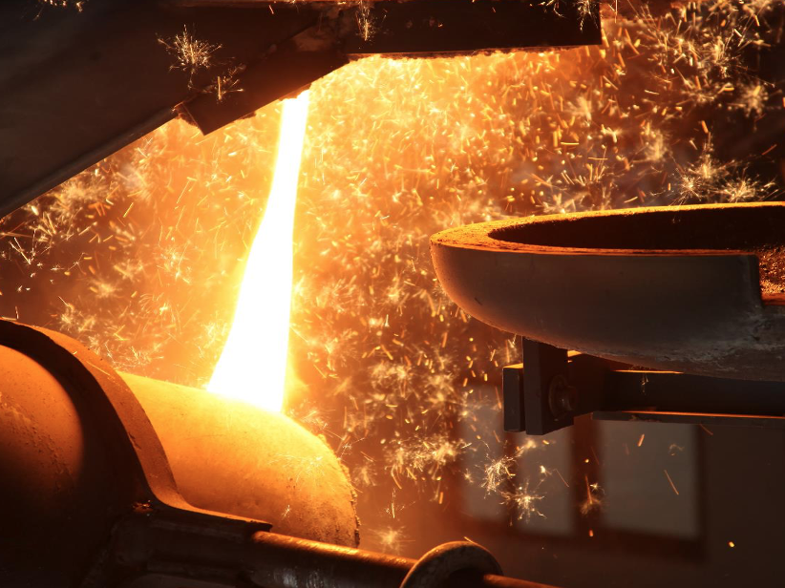


Victorian & Pilbara
Gold & Lithium Projects
RIU Sydney Resources Round-up
May 2022
resources limited
ASX: KZR

Slide 2
Forward Looking Statements
Investment Presentation
This Investment Presentation (IP) is not a disclosure document under Chapter 6D of the Corporations Act nor an offer to subscribe for shares. This IP is specifically provided to the receiving party (Recipient) in response to a request for information from the Recipient about Kalamazoo Resources Limited (Kalamazoo or the Company) and its proposed mineral projects, for the purpose of considering an investment in the Company. This IP is provided by the Company to the Recipient on a confidential and personal basis and is not intended for, and should not be distributed to, any other person. By receipt of this IP, the Recipient agrees that the Recipient will not transmit, reproduce or make available this IP (or any information contained in it) to anyone other than the Recipient’s professional advisers without the prior written consent of the Company.
The information in this IP for the Pilbara Lithium projects and Victorian Projects is based on information compiled by Dr Luke Mortimer, a competent person who is a Member of The Australian Institute of Geoscientists. Dr Mortimer is an employee engaged as the Exploration Manager Eastern Australia for the Company and has sufficient experience which is relevant to the style of mineralisation and type of deposit under consideration and to the activity which he is undertaking to qualify as a Competent Person as defined in the 2012 Edition of the ‘Australasian Code for Reporting of Exploration results, Mineral Resources and Ore Reserves’. Dr Mortimer consents to the inclusion in this document of the matters based on his information in the form and context in which it appears.
The information in this IP relating to the exploration data for the Ashburton and Mallina West Gold Projects is based on information compiled by Mr. Matthew Rolfe, a competent person who is a Member of The Australasian Institute of Geoscientists. Mr. Rolfe is an employee of Kalamazoo Resources Ltd and is engaged as Exploration Manager Western Australia for the Company. Mr. Rolfe has sufficient experience which is relevant to the style of mineralisation and type of deposit under consideration and to the activity which he is undertaking to qualify as a Competent Person as defined in the 2012 Edition of the ‘Australasian Code for Reporting of Exploration Results, Mineral Resources and Ore Reserves’. Mr. Rolfe consents to the inclusion in this document of the matters based on his information in the form and context in which it appears.
The information in this announcement that relates to the estimation and reporting of mineral resources at the Ashburton Project is based on information compiled by Dr Damien Keys, a competent person who is a Member of Australian Institute of Geoscientists. Dr Keys is an employee of Complete Target Pty Ltd who is engaged as a consultant to Kalamazoo Resources Limited. Dr Keys has sufficient experience which is relevant to the style of mineralisation and type of deposit under consideration and to the activity which he is undertaking to qualify as a Competent Person as defined in the 2012 Edition of the ‘Australasian Code for Reporting of Exploration Results, Mineral Resources and Ore Reserves’. Dr Keys consents to the inclusion in this document of the matters based on his information in the form and context in which it appears.
The information in this report that relates to metallurgical test work results is based on information reviewed by Mr David Pass, who is a Member of the Australasian Institute of Mining and Metallurgy. Mr Pass is an employee of Battery Limits. Mr Pass has sufficient experience relevant to the mineralogy and type of deposit under consideration and the typical beneficiation thereof to qualify as a Competent Person as defined by the 2012 Edition of the Australasian Code for Reporting of Exploration Results, Mineral Resources and Ore Reserves (the JORC Code, 2012 Edition). Mr Pass consents to the inclusion in the report of the matters based on the reviewed information in the form and context in which it appears.
The information in this IP that relates to the Mineral Resources for the Ashburton Project is based on information announced to the ASX on 23 June 2020. The Company confirms that it is not aware of any new information or data that materially affects the information included in the relevant market announcements, and that all material assumptions and technical parameters underpinning the estimates in the relevant market announcement continue to apply.
Forward Looking Statements
This IP may contain forward-looking information within the meaning of Canadian securities legislation and forward-looking statements within the meaning of the United States Private Securities Litigation Reform Act of 1995 (collectively, forward-looking statements). Statements regarding Kalamazoo’s plans with respect to its mineral properties and programs are forward-looking statements. There can be no assurance that Kalamazoo’s plans for development of its mineral properties will proceed as currently expected. There can also be no assurance that Kalamazoo will be able to confirm the presence of additional mineral resources/reserves, that any mineralisation will prove to be economic or that a mine will successfully be developed on any of Kalamazoo’s mineral properties. The performance of Kalamazoo may be influenced by a number of factors which are outside the control of the Company and its Directors, staff and contractors.
Previously Released ASX Material References
For further details relating to the Company’s Projects and information in this announcement please refer to the following ASX announcements:
ASX: SRI: 14 February 2011
ASX: NST: 14 February 2011
ASX: NST 28 July 2011
ASX: NST 2 April 2012
ASX: NST 2 July 2012
ASX: NST 26 July 2012
ASX: NST: 27 August 2012
ASX: NST 10 September 2012
ASX: NST 7 February 2013
ASX: NST 28 February 2013
ASX: KZR 20 November 2017
ASX: KZR 20 June 2018
ASX: KZR 14 November 2018*
ASX: NST: 1 August 2019
ASX: KZR 19 October 2019*
ASX: KZR 2 December 2019*
ASX: KZR 15 January 2020
ASX: CAI 19 February 2020
ASX: DEG 27 April 2020
ASX: KZR 29 April 2020
ASX: CMM 12 May 2020
ASX: KZR 3 June 2020*
ASX: NST 22 June 2020
ASX: KZR 23 June 2020
ASX: KZR 4 August 2020
ASX: KZR 28 August 2020*
ASX: KZR 23 September 2020
ASX: KZR 19 October 2020
ASX: KZR 27 October 2020*
ASX: KZR 5 November 2020*
ASX: KZR 22 December 2020
ASX: KZR 5 January 2021*
ASX: KZR 8 July 2021
ASX: KZR 22 July 2021
ASX: KZR 23 August 2021
ASX: KZR 8 September 2021
ASX: KZR 5 October 2021
ASX: KZR 16 December 2021
ASX: KZR 20 January 2022
ASX: KZR 24 January 2022
ASX: KZR 9 February 2022
ASX: KZR 28 February 2022
ASX: KZR 12 April 2022
ASX: KZR 20 April 2022
Disclaimer
This IP does not purport to contain all the information that a prospective investor may require in relation to the Company’s mineral projects. In all cases, before acting in reliance on any information, the Recipient should conduct its own investigation and analysis and should check the accuracy, reliability and completeness of the information and obtain independent and specific advice from appropriate professional advisers. The Company makes no representation, or warranty (express or implied) as to the accuracy, reliability or completeness of the information. The Company and its respective Directors, employees, agents and consultants shall have no liability for any statements, opinions, information or matters arising out of, or for any omissions from, this IP, except liability under law that cannot be excluded.
Competent Persons Statement
The information in this report that relates to Exploration Results for Mallina West, Pilbara Lithium and Ashburton Projects are extracted from the Company’s ASX announcements as referred to above (see releases marked *) and are available to view on www.kzr.com.au. The Company confirms that it is not aware of any new information or data that materially affects the information included in the original market announcements.
ASHBURTON GOLD PROJECT MINERAL RESOURCES
 | INDICATED |  |  | INFERRED |  |  | TOTAL
 | Tonnes (000’s) | Grade (g/t) | Ounces (000’s) | Tonnes (000’s) | Grade (g/t) | Ounces (000’s) | Tonnes (000’s) | Grade (g/t) | Ounces (000’s) | Cut off Grade (g/t Au)
Mt Olympus | 6,038 | 2.3 | 448 | 9,138 | 2.2 | 632 | 15,176 | 2.2 | 1,080 | 0.7
Peake | 113 | 5.2 | 19 | 3,544 | 3.3 | 380 | 3,657 | 3.4 | 399 | 0.9
Waugh | 347 | 3.6 | 40 | 240 | 3.6 | 28 | 587 | 3.6 | 68 | 0.9
Zeus | 508 | 2.1 | 34 | 532 | 2.2 | 38 | 1,040 | 2.2 | 72 | 0.9
Romulus | - | - | - | 329 | 2.6 | 27 | 329 | 2.6 | 27 | 0.9
TOTAL RESOURCE | 7,006 | 2.4 | 541 | 13,783 | 2.5 | 1,105 | 20,789 | 2.5 | 1,646

Slide 3
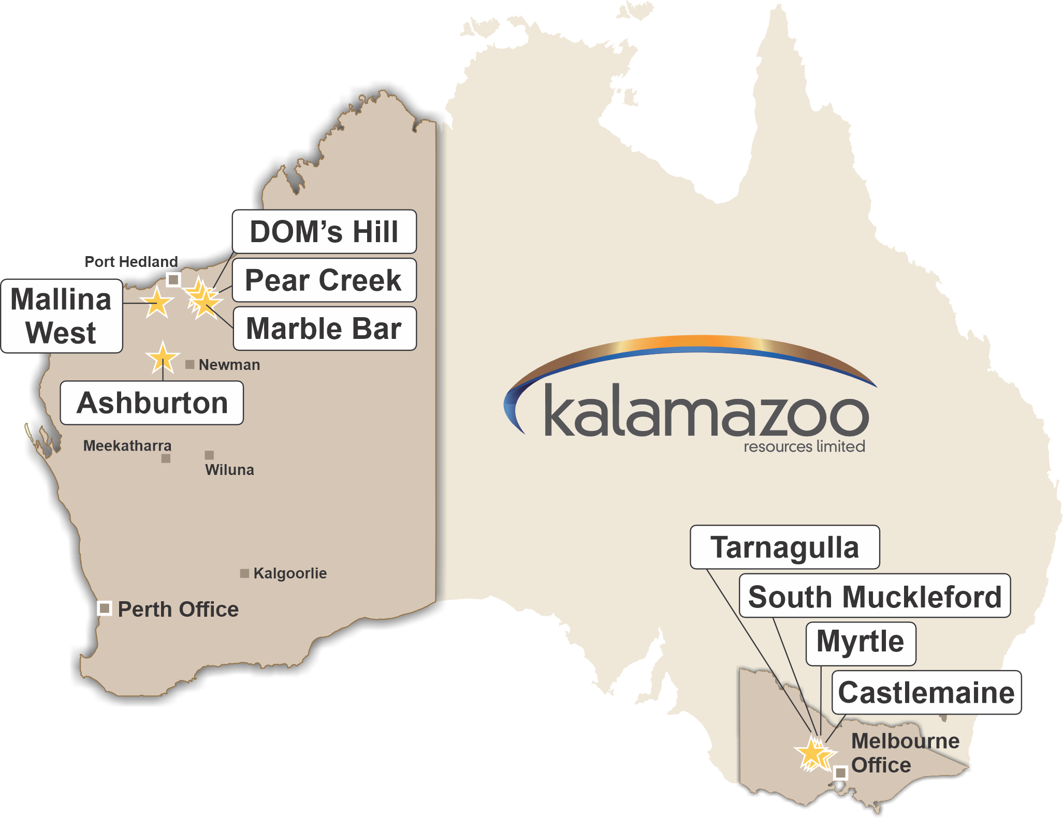
The Kalamazoo Story
An Australian gold and lithium explorer with major assets in two
of the richest mineral provinces in the world
Gold Projects
Pilbara Craton
Ashburton Gold Project
  Previous production of ~350,000oz @ 3.3g/t Au in 1998-2004
  Current JORC Code (2012) Resource of 1.65Moz comprised of 20.8Mt @ 2.5g/t Au¹ and growing
  Recent outstanding metallurgical test work provides clear development pathway²
Drilling underway at highly prospective Mallina West Gold Project along strike from De Grey’s Hemi discovery
Victorian Goldfields
  Exploring for the next major gold deposit in Victoria, close to Fosterville
  Major projects in the Bendigo Zone with advanced exploration/drill programs at:
        Castlemaine Gold Project (5.6Moz historical production)³
        South Muckleford Gold Project (2.1Moz historical field production)³
      Lithium Projects – Marble Bar
      Drilling to commence in major exploration JV with SQM at DOM’s Hill and Marble Bar Lithium Projects²
      Exploration underway at highly prospective 100% owned Pear Creek Lithium project
Our strategy is to acquire and discover mineral projects that create tangible shareholder value
1. ASX: KZR 23 June 2020 2. ASX:KZR 20 April 2022 3. Willman et al 2002 Geology Survey Victoria, Report 4. ASX: KZR 12 April 2022

Slide 4
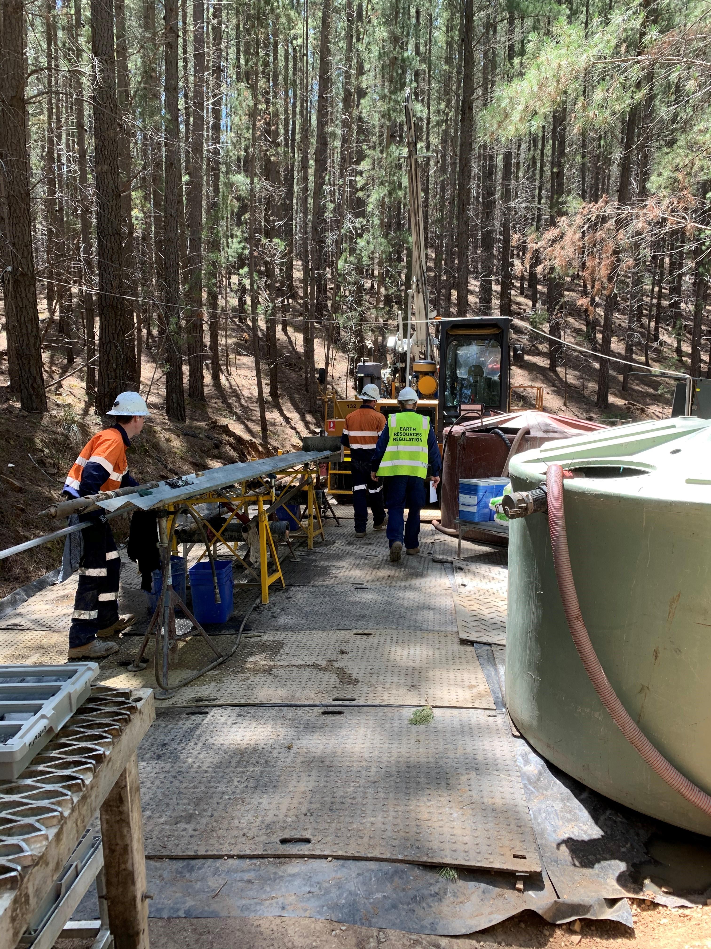
ESG – Kalamazoo’s Licence to Operate
Fully accredited Carbon Neutral
  First carbon neutral gold and lithium explorer operating in Australia under Climate Active Program¹
  2022 emissions fully offset (with WA reforestation) with commitment to carbon neutrality
Indigenous Stakeholders
  Acknowledge and committed to working with the Traditional Owners of the lands on which we operate
Health, Safety, Environment & Community Policy
  Fundamental commitment to HSEC principles
  Excellent safety record
  Proactive approach to Community Engagement
Corporate Governance
  Board level commitment to transparency, accountability and security
Drilling in Pine Plantation, Castlemaine Gold Project, Victoria 2021
1. ASX: KZR 9 February 2022

Slide 5
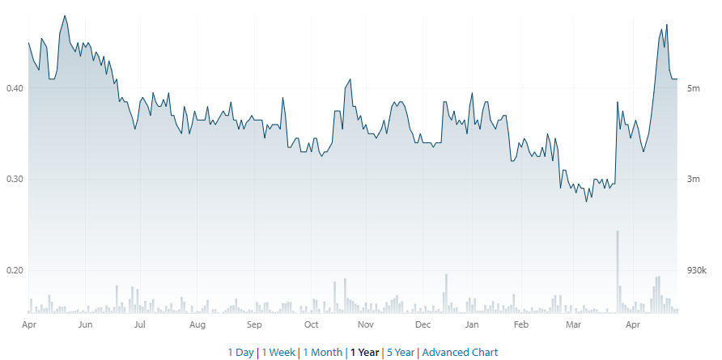
Corporate Overview
Substantial Shareholders
Board & Management
Capital Structure
Luke Reinehr Executive Chairman/CEO
Paul Adams Executive Director
Angus Middleton Non-Executive Director
Bernard Crawford CFO/Company Secretary
Dr. Luke Mortimer Exploration Manager
Matthew Rolfe Exploration Manager - West
Shares¹ | 145,194,374
Performance Rights | 4,250,000
Unlisted Options | 12.400,000
Market Cap ($0.41) | A$59.5m
Cash² | A$4.3m
1. As at 31 March 2022
Options
$0.42 exp. 30/11/2022 | 9.5m
$1.04 exp. 30/11/2023 | 1.4m
$0.69 exp. 15/03/2024 | 1.5m
Share Price Performance
The Top 5 hold 50.1%
The Top 20 hold 61%

Slide 6
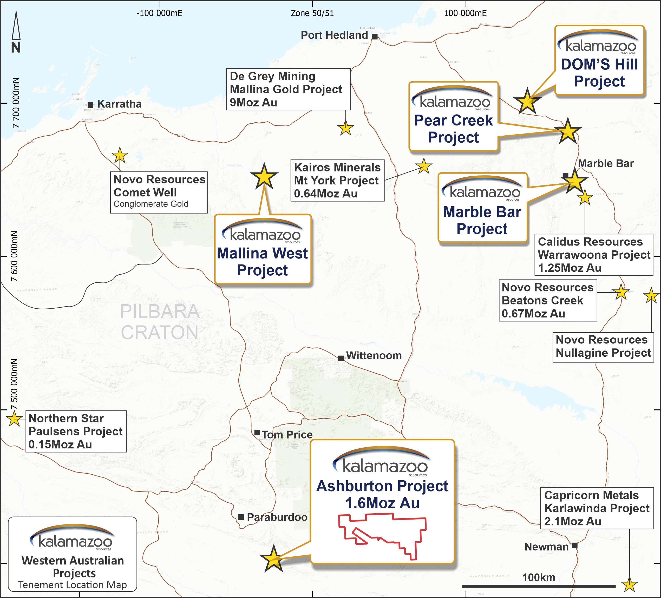
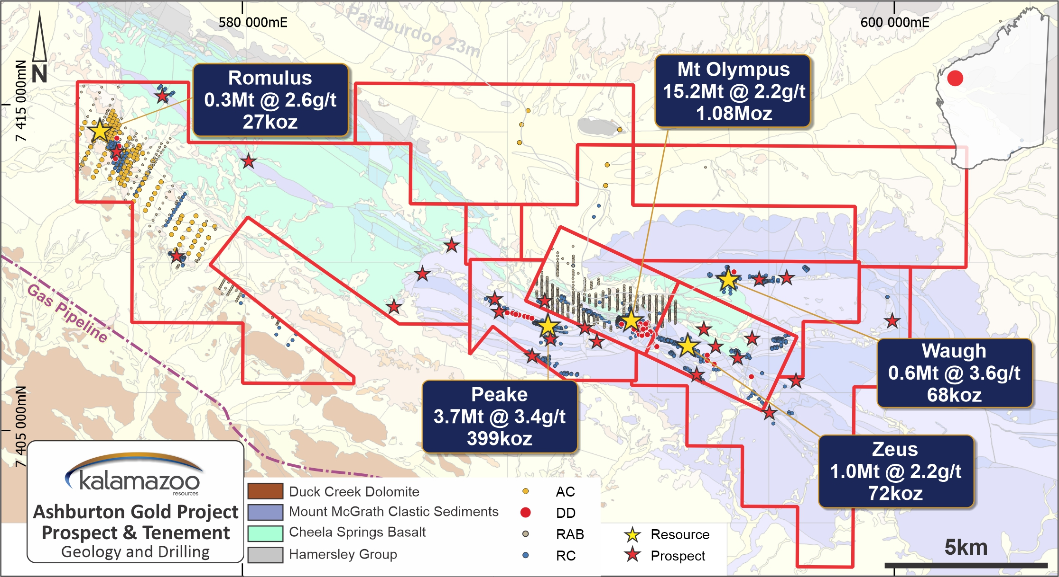
Pilbara: Ashburton Gold Project
Kalamazoo’s Ashburton Project of 1.65Moz @ 2.5g/t compares well on grade with Pilbara peers:
  De Grey’s Mallina Project (9Moz @1.2g/t)¹
  Calidus’ Warrawoona Project (1.7Moz @1.2g/t)²
  Capricorn’s Karlawinda Project (2.1Moz @0.8 g/t)³
  Novo’s Beatons Creek Project (~0.9Moz)⁴
1.65Moz sulphide/oxide resource: potential for significant expansion and development
Major Drilling Programs:
    5,781m Phase 1 drilling completed Dec. 2020⁵
    14,772m Phase 2 drilling completed Sept. 2021⁶
    Extensive Phase 3 program in planning for 2022
Positive metallurgical studies leading to Scoping Study to progress development pathway
ASX: DEG 23 June 2021, 2. ASX: CAI 9 March 2022
3. ASX: CMM 12 May 2020
4. Novo Resources Media release 4 August 2020
5. ASX: KZR 5 January 2021 6. ASX: KZR: 5 October 2021

Slide 7
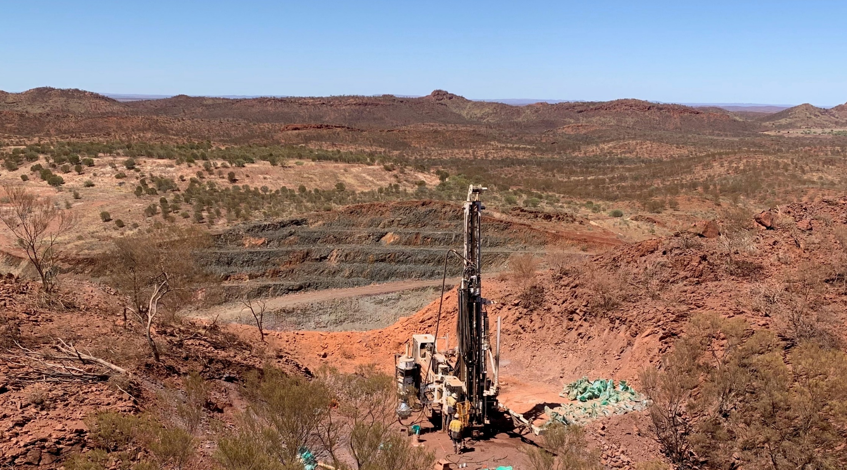
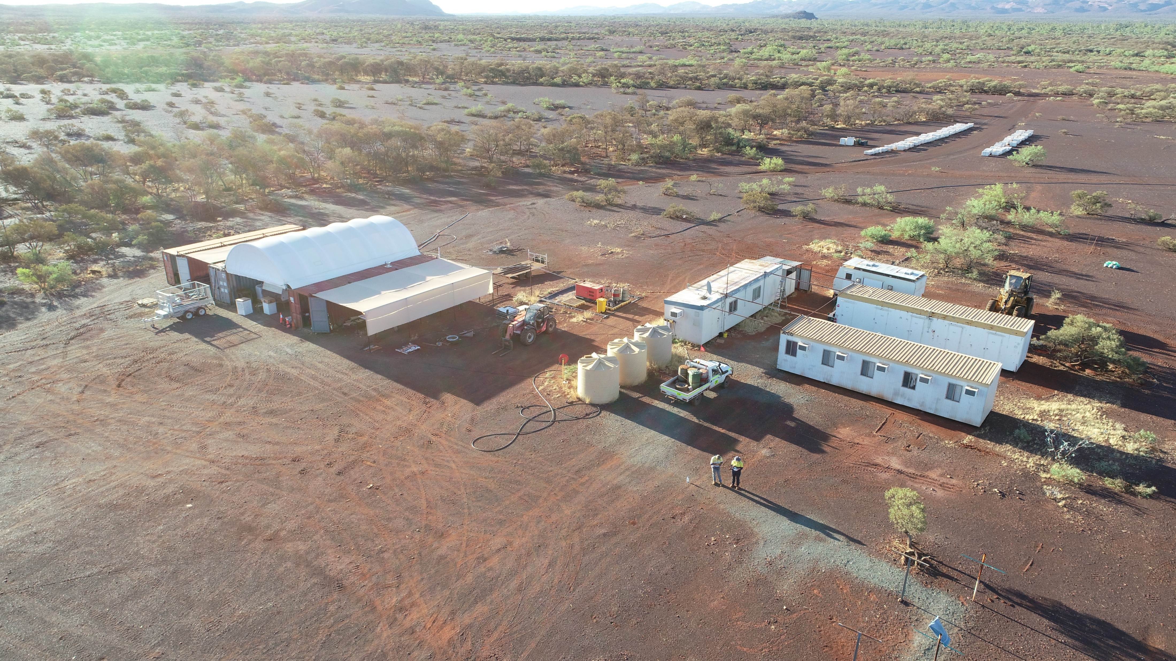
Pilbara: Expanding the Ashburton Resource
Focus is on near-mine and regional exploration potential with aim to expand resource well past 2Moz
Major Phase 1 and 2 drilling programs have achieved:
  Moderate/high grade mineralisation extending NW/SE of the Waugh Pit by 2.5km (“Waugh Zone”)
  Shallow conglomerate hosted gold mineralisation at Annie Oakley sharing many similarities with the nearby 1.08Moz Mt Olympus deposit
  Mt Olympus resource drilled to provide bulk samples for gold deportment studies & metallurgical test work
  Opportunity to substantially increase oxide & sulphide resources, including between the Mt Olympus 1.1Moz Resource and nearby West Olympus Deposit
  Planning underway for major Phase 3 drilling in 2022
Drilling at the Waugh Prospect November 2020
Fully operational exploration camp

Slide 8
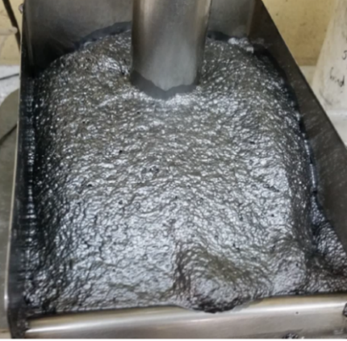
Pilbara: Ashburton Development Pathway
Northern Star’s 2013 plan was to build initial 100,000oz pa oxide CIL plant then Stage 2 Sulphide Circuit
Gold price in 2013 fell to ~A$1,300 so NST put future development on hold
Gold price now ~A$2,600 and Kalamazoo is undertaking its own development and metallurgical studies
  Outstanding gold recoveries on four metallurgical composites from the 1Moz Mt Olympus deposit
  Excellent gold recovery into rougher concentrate of up to 94%
  Gold in concentrate averaged 32 g/t Au with maximum value of 39 g/t Au
  Additional test work increased grade on Composite 4 from 39 g/t Au to 45 g/t Au
Test work indicates that a crush/grind/rougher float multi-stage re-clean circuit is the simplest, least capital intensive and most easily operable process route for the Mt Olympus sulphide mineralisation
Project Development Scoping Study to commence Q2, 2022
Flow sheet diagram for test work and froth float from test

Slide 9
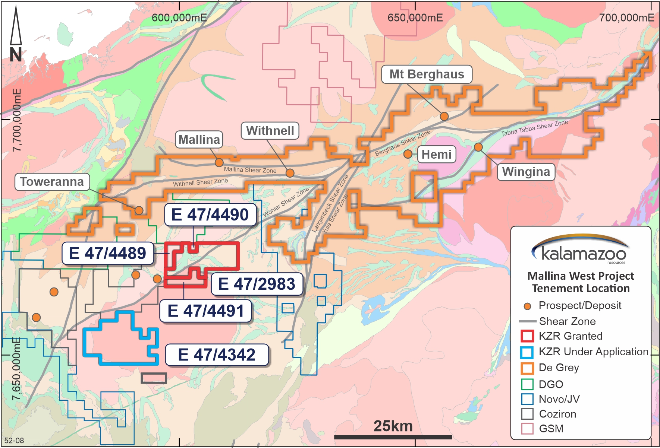
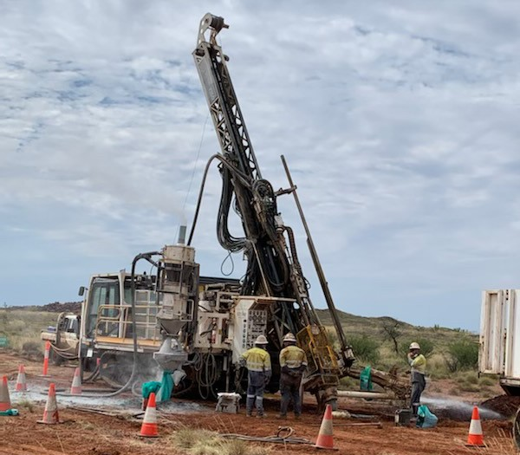
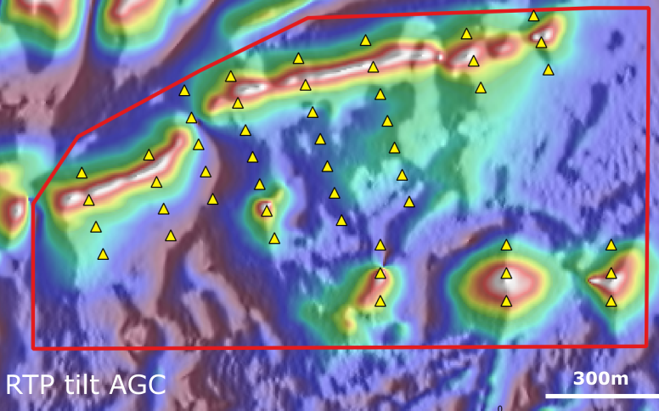
Pilbara: The Mallina West Gold Project
Along the same shear zone as De Grey’s world class Hemi discovery¹
Ultrafine+TM soil sampling and airborne surveys identified 5 highly prospective targets
~2,500m RC drill campaign underway targeting distinct gold-in-soil highs at Wattle Plains Prospect
1. ASX: DEG 17 December 2019, 6 February 2020, 27 May 2020, 5 June 2020, 9 June 2020

Slide 10
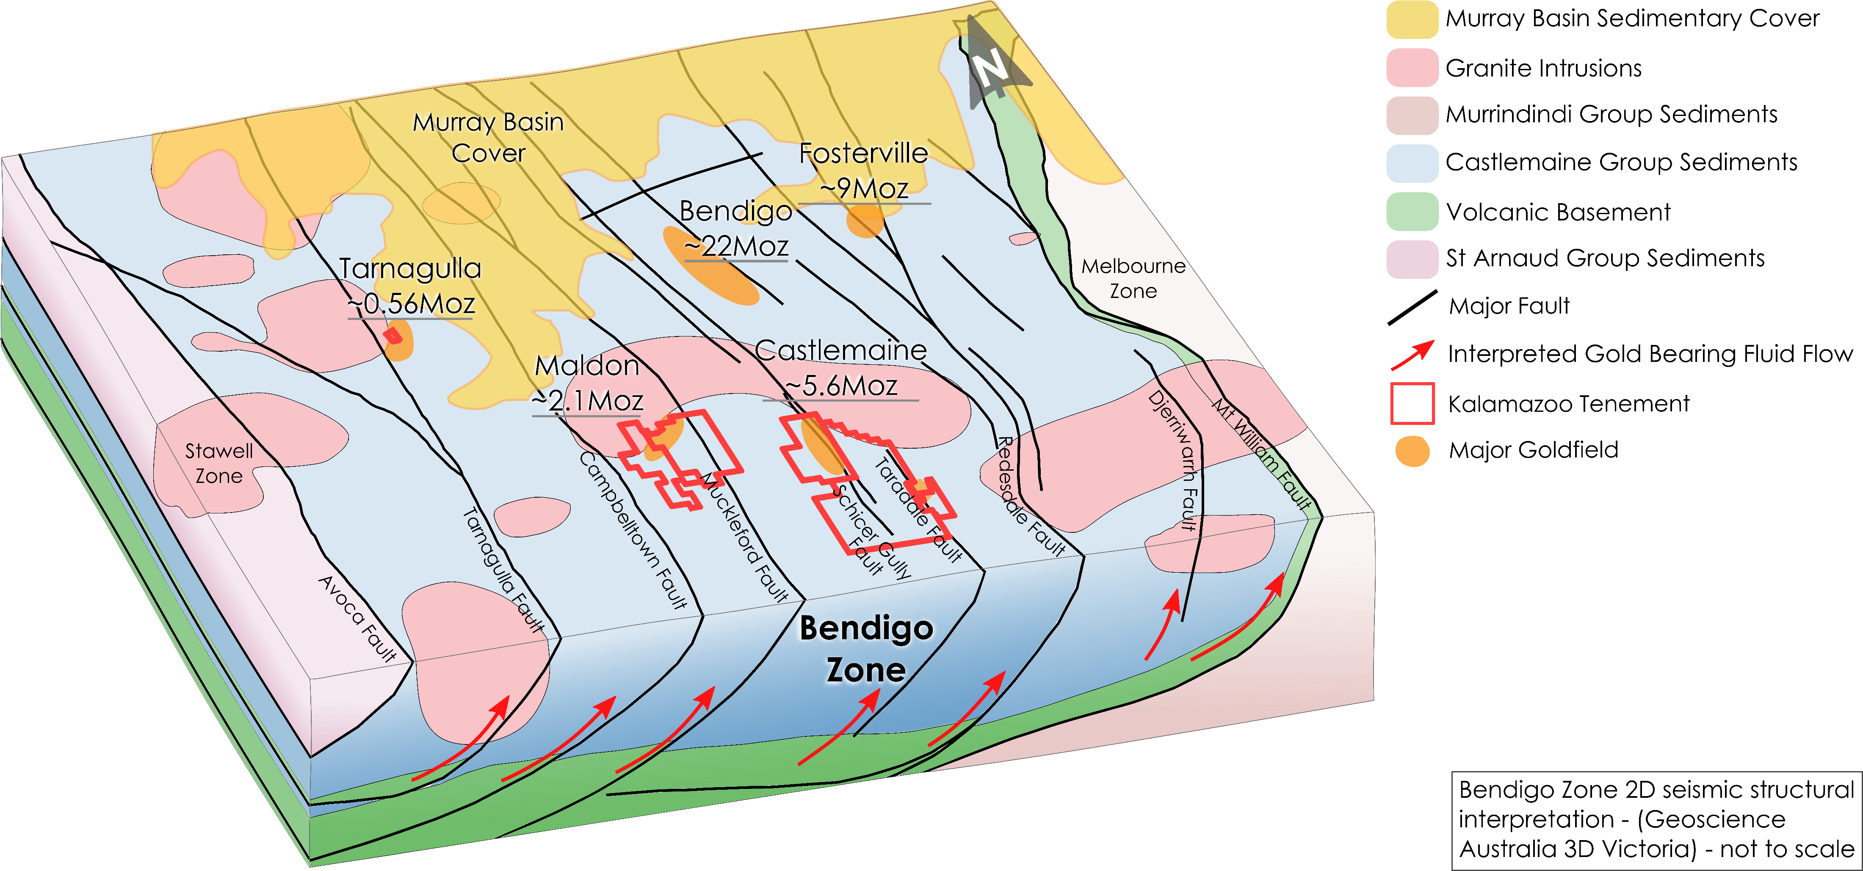
Victoria: Bendigo Zone
Bendigo Zone: 60M+ oz Au¹ at average grade of ~ 15g/t Au²
Kalamazoo exploring 485km² of major goldfields - right locations for next World-Class discovery
Limited modern exploration, Castlemaine historical drilling averaged just 137m, exploring smarter
1. Willman et al 2002, Geology Survey Victoria, Report 121, 2. Source: Ross Cayley, “Gold in Victoria – The Current State of Play”,

Slide 11
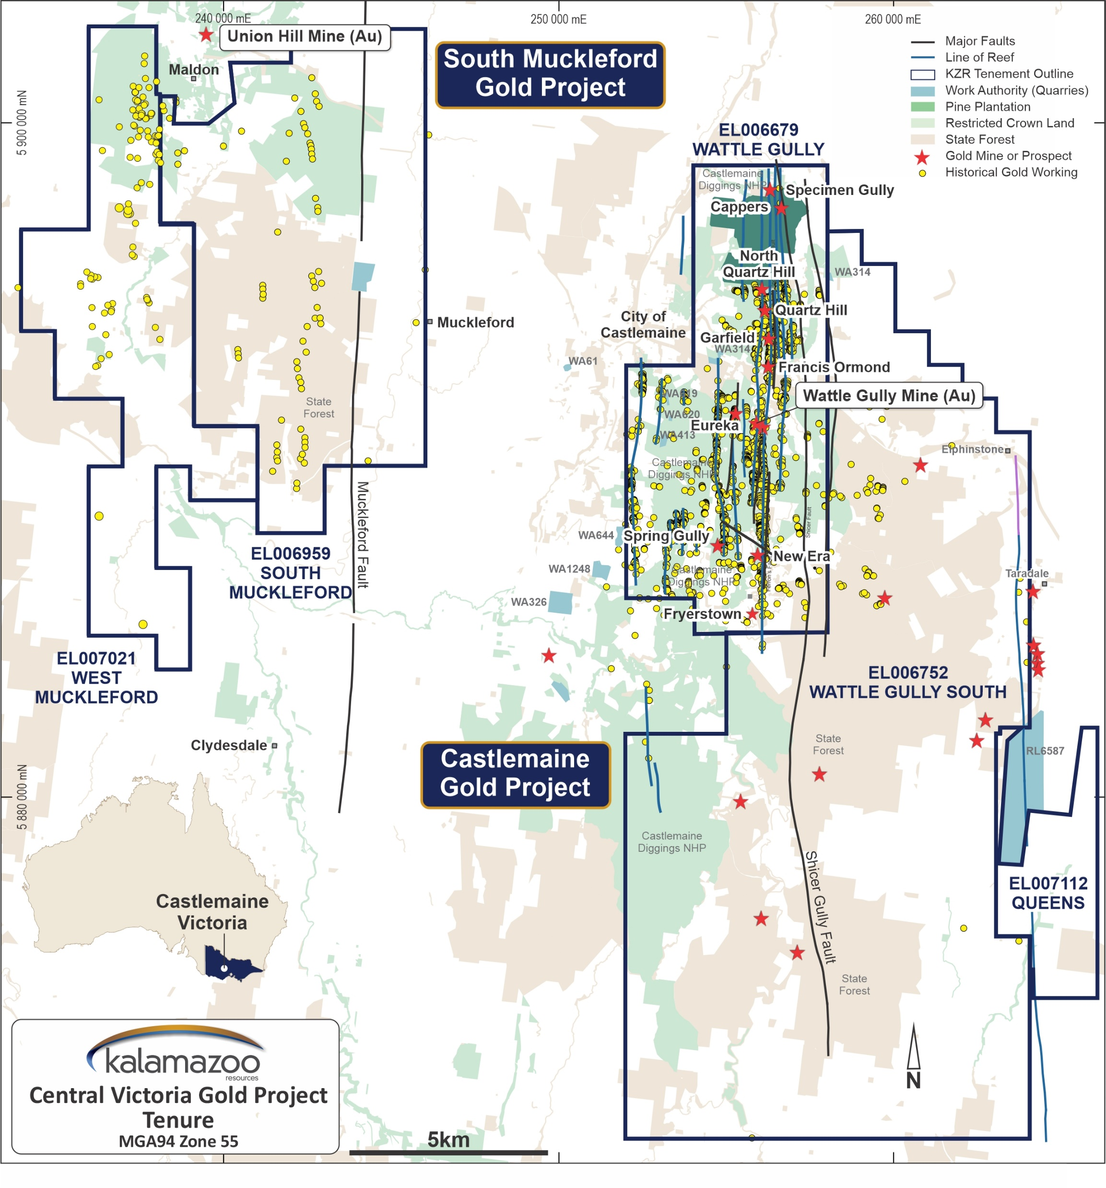
Victoria: Strategy and Target Generation
Discovering high-grade (>10g/t) large resources (1Moz+) in structurally complex goldfields
New approach required – thinking differently
Exploring smarter and innovating with “Low Impact” technologies:
UltraFine+TM Soil/Mica Sampling Programs (CSIRO)
Induced Polarisation (IP), Ground Magnetic Surveys
LiDAR, 3D Geological Modelling, Fieldwork
Different techniques for specific geological settings
10 high priority prospects already identified:
Mustang 4,500m drilled - (e.g. 1.42m@ 261g/t Au)¹
Lightning – drilled (2.5km mineralised trend)²
Fentiman: epizonal Au/Sb discovery – drilled^{3, 4}
South Muckleford
Wattle Gully extensions
Tarnagulla Gold Project – upcoming drill program
Extensive programs over next 24 months
Fentimans
Prospect
Mustang
Prospect
Lightning
Prospect
1. ASX: KZR 29 April 2020 2. ASX: KZR 22 December 2020 3. ASX: KZR 22 December 2020 4. ASX: KZR 22 July 2021

Slide 12
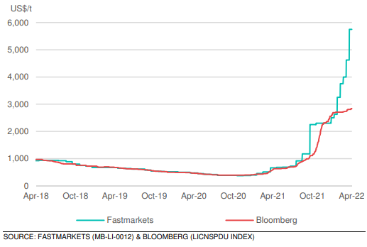
Kalamazoo’s Pilbara Lithium Strategy
Major tenement package (354km²) in the Pilbara highly prospective for hard-rock lithium deposits
Unrivalled exploration and development JV with SQM, the world’s 2nd largest lithium producer (~19% global supply)
Searching for major lithium resources within Kalamazoo’s Pilbara project areas - potentially a transformational event
SQM is a high-quality partner with significant lithium exploration, construction and operating experience
Transaction provides opportunity to create substantial share holder value with extensive lithium exploration now sole funded by SQM with initial $12m earn-in¹
Spodumene price (min. 5-6%), CIF China
Common goal of discovering and developing major lithium deposits with Kalamazoo retaining minimum 30% interest, with 1st right to acquire respective interests – provides upside if smaller project identified
The SQM JV enables Kalamazoo to direct its financial resources on exploring & developing other lithium projects, 1.65Moz Ashburton Gold Project, Mallina West and Victorian gold assets
1. ASX: KZR 16 December 2021

Slide 13
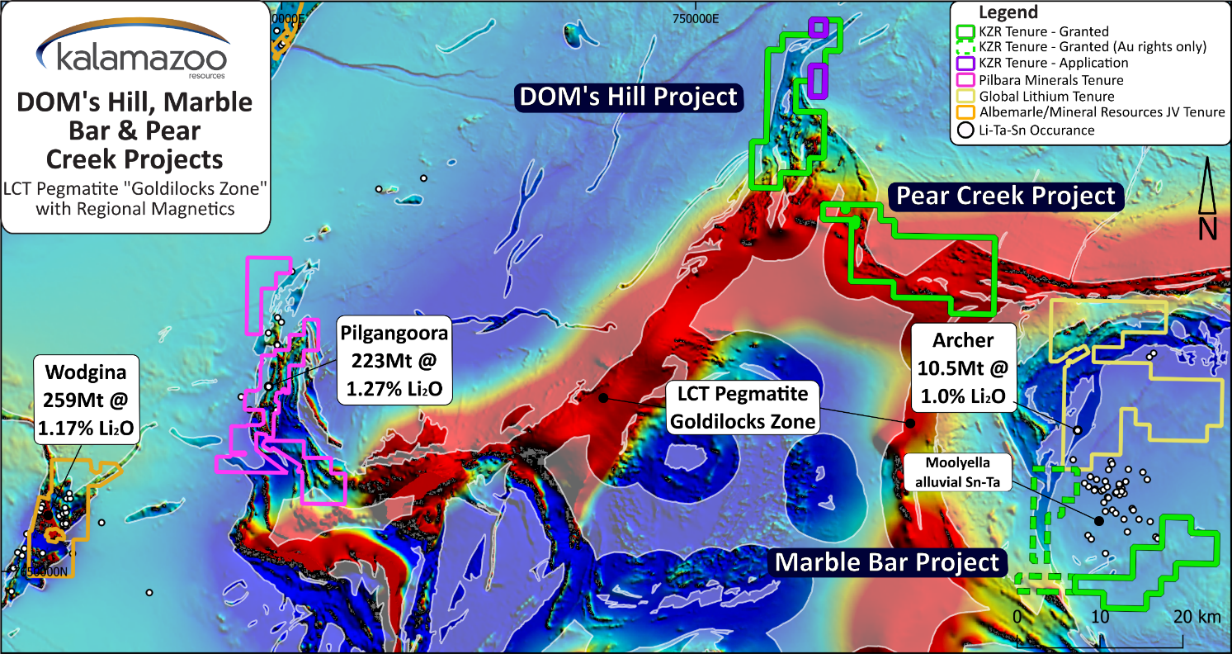
Pilbara Lithium Projects
The Pilbara is the pre-eminent World-class hard rock lithium field:
  Pilbara Minerals’ Pilgangoora Lithium Mine (223Mt @ 1.27% Li₂O) – geological analogue 50kms SW
  Albemarle/MinRes” Wodgina Lithim Mine (259Mt @ 1.17% Li₂O) – geological analogue 70kms SW
  Global Lithium’s Archer Deposit (10.5Mt @ 1.0% Li₂O) – 25kms to the N
Kalamazoo has discovered multiple priority target areas for pegmatite mineralisation across its 354km² Pilbara lithium landholding at the DOM’s Hill, Marble Bar and Pear Creek Lithium Projects
1. ASX: KZR 23 August 2021 2. ASX: KZR: 8 September 2021

Slide 14
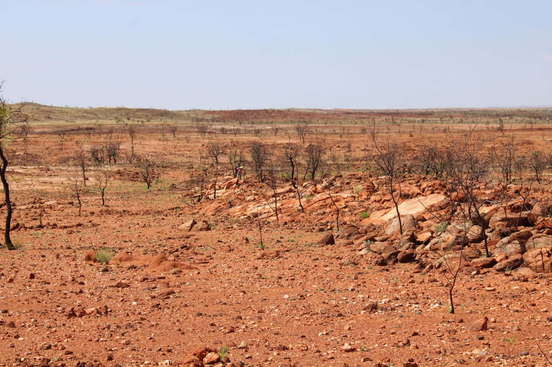
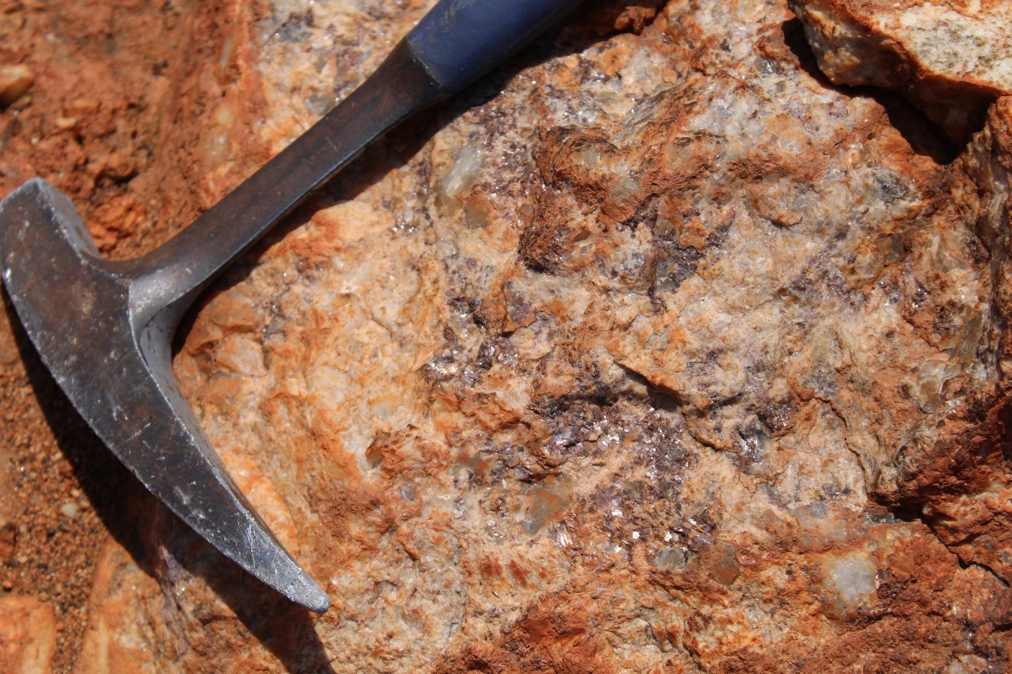
Pilbara Lithium Projects - Exploration
Marble Bar:
On margin of Moolyella tin/tantalum field
Project wide soil sampling program (3,706 samples)
Recent field work has identified significant LCT pegmatite-hosted mineralisation potential
Lithium mineralised pegmatite dykes including visible lithium (lepidolite) align with pXRF Li index geo-chemical soil anomalies
DOM’s Hill:
Located within “Goldilocks Zone” (prospective Archaean granite-greenstone contact)
Recent field work has identified significant LCT pegmatite-hosted mineralisation potential
Pear Creek:
~25kms of Goldilocks strike zone
Initial regional soil sampling program (~2,300 samples) to commence mid-May 2022
RC drill programs to start June 2022
Lepidolite mineralised pegmatite dyke and lithium mica at Marble Bar
1. ASX: KZR 23 August 2021 2. ASX: KZR: 8 September 2021

Slide 15
ASX Gold Peer Valuations¹
$94 Av.
Kalamazoo Resources
Note: Nil ounce value allocated to Kalamazoo’s Lithium, Pilbara or Victorian Gold Projects
1. Source data provided in Appendix 1 2. Includes Measured, Indicated and Inferred Mineral Resources

Slide 16
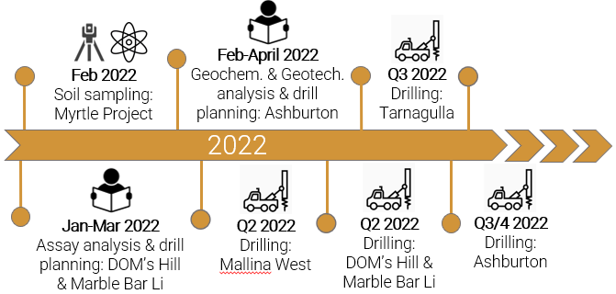
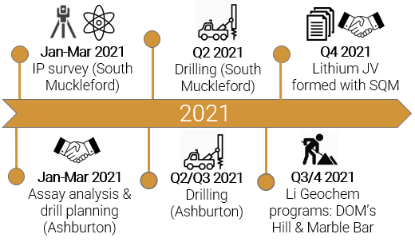
Investment Highlights
Major assets in two of the most highly rated gold and lithium provinces in the world today
Ashburton Gold Project – expanding 1.65Moz @ 2.5g/t Au resource and development pathway¹
Major SQM JV exploration underway at DOM’s Hill and Marble Bar Lithium Projects
Searching for the next Victorian world-class gold discovery utilising latest technologies
Eric Sprott and Novo Resources are strategic cornerstone investors
Fully funded with $4.9m cash and stock²
Building on past work, major 2022 exploration/drilling programs are underway across portfolio
1. ASX: KZR 23 June 2020 and ASX: KZR 5 January 2021 2. ASX: KZR 23 September 2020

Slide 17
Contact Us
resources limited
Luke Reinehr
Chairman/CEO
Unit 3, 328 Reserve Road
Cheltenham 3192, Victoria
+61 3 9988 9007
luke.reinehr@kzr.com.au
Paul Adams
Executive Director
16 Douro Place
West Perth 6005, Western Australia
1300 782 988
paul.adams@kzr.com.au
Victoria Humphries
Investor Relations
+61 (0) 431 151 676
victoria@nwrcommunications.com.au
Focus Communications
Leo Karabelas: leo@fcir.ca
Tom Panoulias: tom@fcir.ca
ACN: 150 026 850
ASX: KZR
FRA: KR1
www.kzr.com.au

Slide 18
Appendix 1
Source Date for EV/Resource ASX Gold Peer Comparison
Company | CAI | BGL | MGV | GMD | AUC | VAN | KAI | HRZ | KIN | BRB | STN | MEK | KZR | HRN | RXL | MDI
Price (ASX Closing Price) | 29-Apr-22 | 29-Apr-22 | 29-Apr-22 | 29-Apr-22 | 29-Apr-22 | 29-Apr-22 | 29-Apr-22 | 29-Apr-22 | 29-Apr-22 | 29-Apr-22 | 29-Apr-22 | 29-Apr-22 | 29-Apr-22 | 29-Apr-22 | 29-Apr-22 | `
Shares (Appendix 2A/3B) | 14-Mar-22 | 22-Apr-22 | 19-Nov-21 | 22-Apr-22 | 26-Apr-22 | 05-Nov-21 | 20-Jan-22 | 10-Jan-22 | 12-Nov-21 | 17-Dec-21 | 23-Mar-22 | 28-Oct-21 | 20-Dec-21 | 16-Apr-21 | 03-Mar-22 | 10-Nov-21
Cash (Appendix 5B) | 28-Apr-22 | 22-Apr-22 | 29-Apr-22 | 29-Apr-22 | 22-Apr-22 | 29-Apr-22 | 26-Apr-22 | 26-Apr-22 | 20-Apr-22 | 28-Jan-22 | 26-Apr-22 | 19-Apr-22 | 28-Apr-22 | 20-Apr-22 | 20-Apr-22 | 29-Apr-22
Debt (Appendix 5B) | 28-Apr-22 | 22-Apr-22 | 29-Apr-22 | 29-Apr-22 | 22-Apr-22 | 29-Apr-22 | 26-Apr-22 | 26-Apr-22 | 20-Apr-22 | 28-Jan-22 | 26-Apr-22 | 19-Apr-22 | 28-Apr-22 | 20-Apr-22 | 20-Apr-22 | 29-Apr-22
Mineral Resource (ASX Announcement) | 16-Sep-21 | 08-Jul-21 | 11-Nov-20 | 29-Mar-22 | 07-Dec-21 | 20-May-20 | 04-Mar-20 | 03-Nov-21 | 23-Sep-21 | 20-Dec-21 | 28-Jan-21 | 18-May-21 | 23-Jun-20 | 12-Feb-21 | 20-Jan-22 | 07-Jul-21
Project Stage | Development | Feasibility Study | Feasibility Study | Feasibility Study | Exploration | Exploration | Exploration | Feasibility Study | Exploration | Exploration | Exploration | Feasibility Study | Exploration | Exploration | Exploration | Feasibility Study

